Slide 1
INTERNET AND WEB TECHNOLOGY LAB
ABHAY RAIZADA(13/IT/68)
SHAUNAK SEN(13/IT/82)
SURYA PRAKASH(13/IT/74)

Slide 2
WORK DIVISION (Date : 17/01/2016)
Shaunak : HTML
Abhay : CSS
Surya : Presentation

Slide 3
AIM: To Create Admin and Student Login Project
We wish to create an admin-student login for the purpose of grade and attendance upload and view.
Till now we’ve created a Basic Landing Page for the purpose of registration of the student or admin.
Technologies Used: So far we’ve used basic HTML and CSS

Slide 4
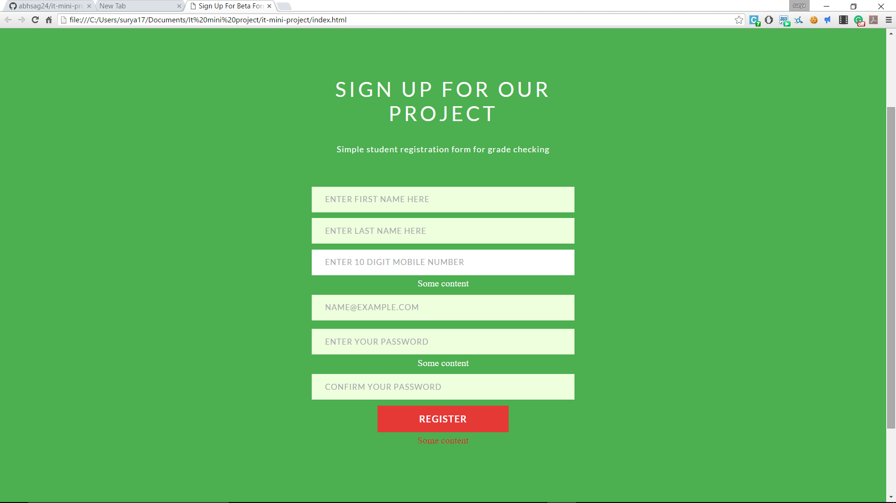
This is the screenshot of the landing page

Slide 5
Description of Landing Page
In the previous slide we have shown the webpage which has fields that are required for registration.
We wish to create a portal where professors can upload and modify the grades and attendance of students and the latter can just check their details by logging in.
Details of this project can be found at https://github.com/abhsag24/it-mini-project

Slide 6
Plan For Next Week(27/01/2016)
We wish to add index page with navigation bar and a link for new user
We also want to add fields for Roll Number, Date Of Birth(calendar), Department(dropdown menu), Year, Profile picture and a reset button
We also want to calculate age , partial roll number and we want to implement form validation

Slide 7
WORK DIVISION (Date : 24/01/2016)
Abhay : HTML additions
Shaunak : Javascript
Surya : CSS modifications and presentation

Slide 8
Second Week’s Work(25/01/2016)
We made a landing page with a navigation bar and a link for new user registration
We added fields for Date of Birth(calendar), Roll number, Department(dropdown menu), year
We used javascript for age calculation and form validation
We stylized our navigation bar, background, all input fields and buttons using css.

Slide 9
Plan For Next Week(03/02/2016)
Add reset button
Add Backend for our webpage
Create different profile pages for students and professors
Add more content to home page and Improve user registration page

Slide 10
WORK DIVISION(Date : 03/02/2016)
Abhay : PHP and MySql
Shaunak : Javascript, CSS
Surya : HTML

Slide 11
Third Week’s Work(03/02/2016)
We’ve added automatic form filling(Roll No. is automatically filled using year and branch )and form validation is done after pressing submit button.
Age is calculated based on date of birth and is displayed
We’ve included the option to upload profile pic(only images are accepted)
We’ve developed partial backend for our website using PHP and MySql
We’ve used Ajax for webpage response

Slide 12
Plan For Next Week(17/02/2016)
We’ll add profile pages for student and admin
We’ll add email verification
We’ll add hobbies and profile pic to our database
We’ll create complete backend for our website

Slide 13
WORK DIVISION(Date : 13/02/2016)
Abhay :
Shaunak :
Surya :

Slide 14
Fourth Week’s Work(14/02/2016)
Added phone number field and validated it
Added Navigation bar
Added Hobbies to the database

Slide 15
Plan For Next Week(24/02/2016)

